Slide 1
Superstore sales dashboard
Task 4: Dashboard Design
Tool Used: Power BI
Name: Dargupally Rithika

Slide 2
Objective :
To create an interactive sales dashboard
To analyze business performance using KPIs
To visualize sales trends and category performance
To help stakeholders make decisions

Slide 3
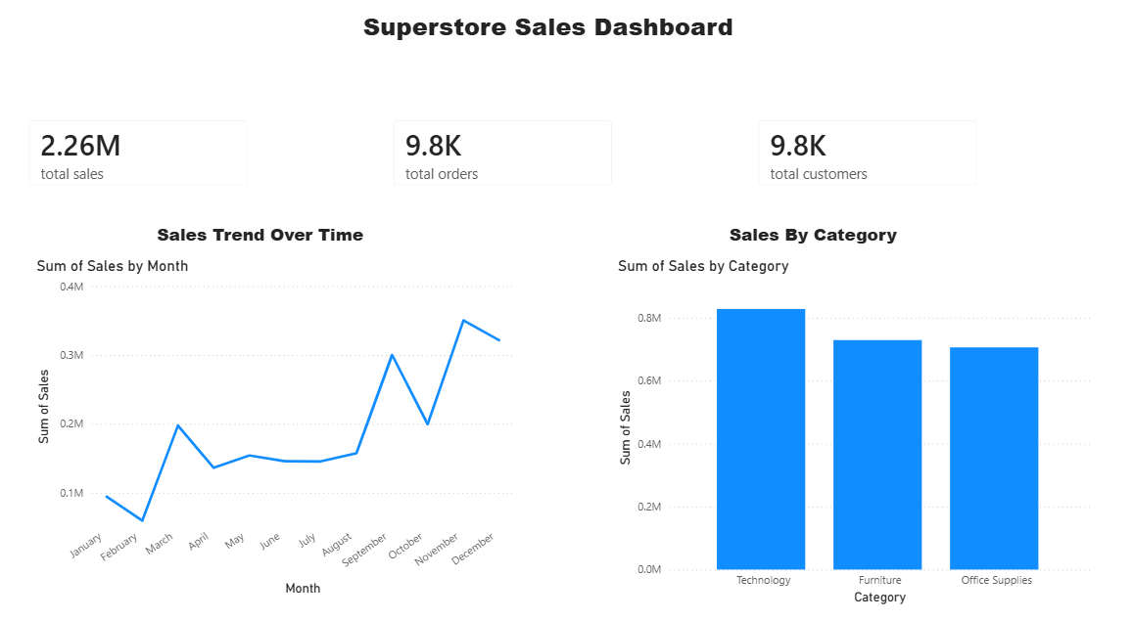
Dashboard overview
KPI Cards: Total Sales, Total Orders, Total Customers
Sales Trend Over Time
Sales by Category

Slide 4
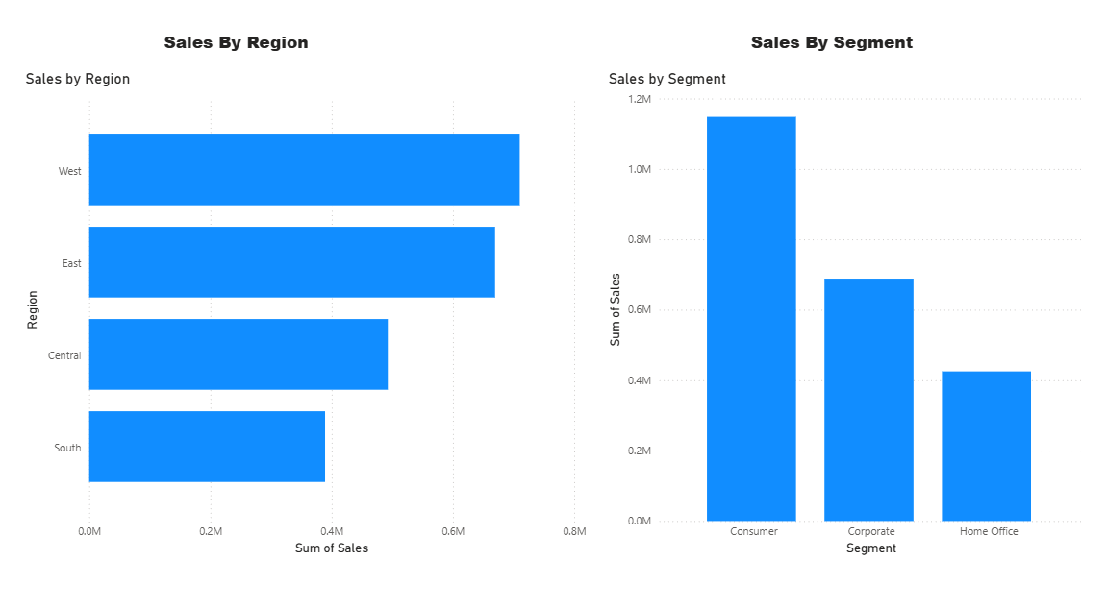
Sales analysis
sales comparison by Region
Sales performance by Segment
Interactive dashboard visuals

Slide 5
Key insights
Sales performance can be tracked over time.
Categories can be compared based on sales.
Regions and segments help identify business performance.
Interactive charts allow better analysis.

